Slide 1

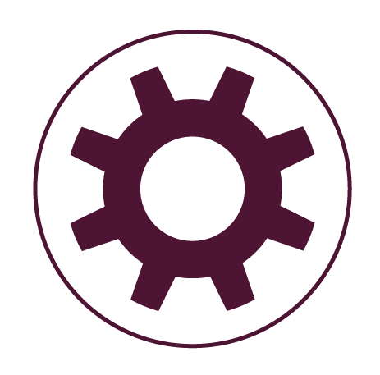



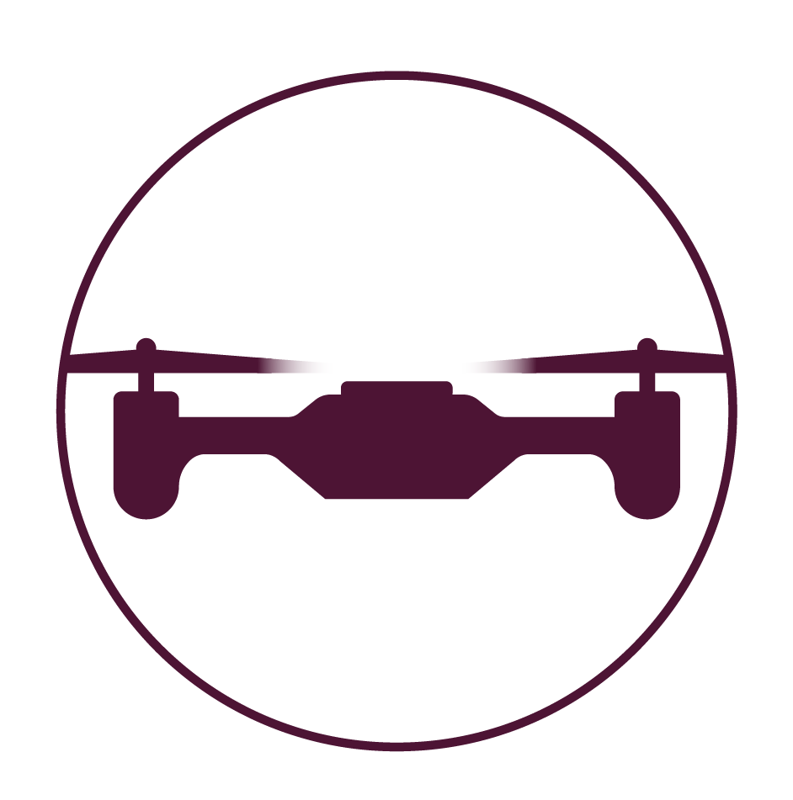
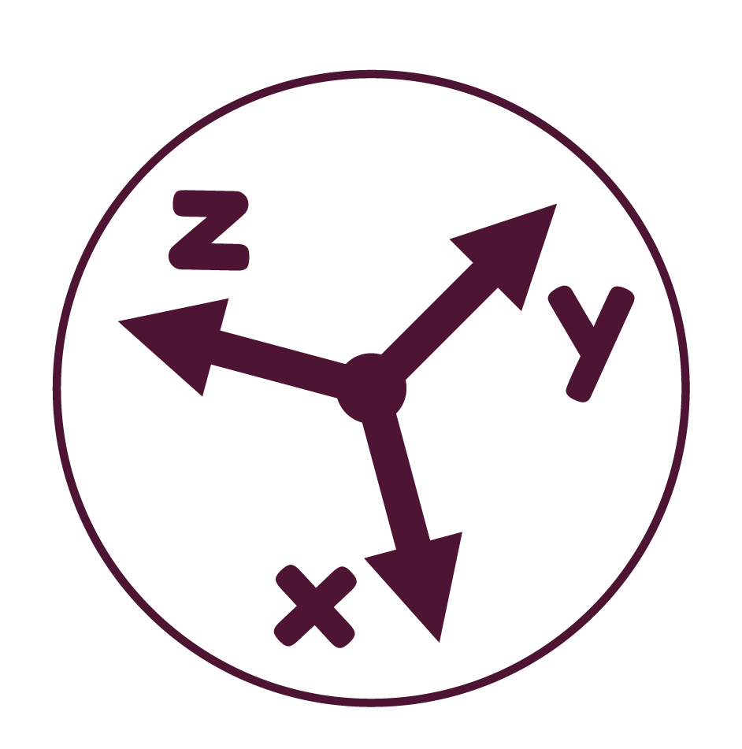

Robotics Lab 5
Gazebo Simulator and
Velocity Messages
MUNADI SIAL
School of electrical engineering and computer science
National University of Sciences and Technology

Slide 2
Overview
This lab will focus on the following objectives:
1. Using the Gazebo Simulator with ROS
2. Cloning a robot package from an existing repository
3. Performing teleoperation in the robot simulation
4. Understanding linear and angular velocities
5. Publishing Twist messages for commanding velocities

Slide 3
Robotic Simulators
A real robot requires significant investments such as high cost, lab space, battery recharging and repairing etc
Even the best robots break periodically due to environmental conditions, operator error and manufacturing defects
Such problems can be avoided by using simulated robots.
In a simulation, we can model as much (or as little) of reality as desired
Sensors and actuators can be modeled as ideal devices or they can have various levels of noise, distortion and errors etc
The vast majority of ROS graph can run identically on both simulations and real robots (although some parameter tuning is required)
There are a number of robotic simulators:
Gazebo
Webots
CoppeliaSim (formerly V-REP)
SimSpark
RoboDK
OpenRAVE

Slide 4
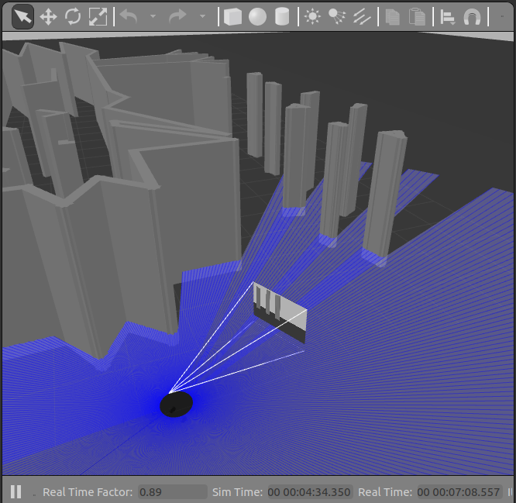
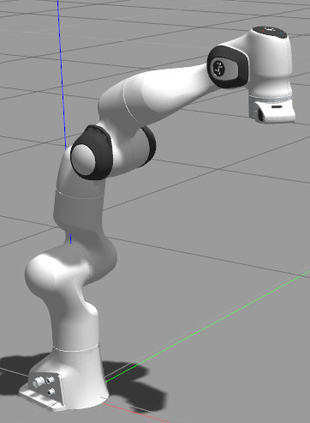

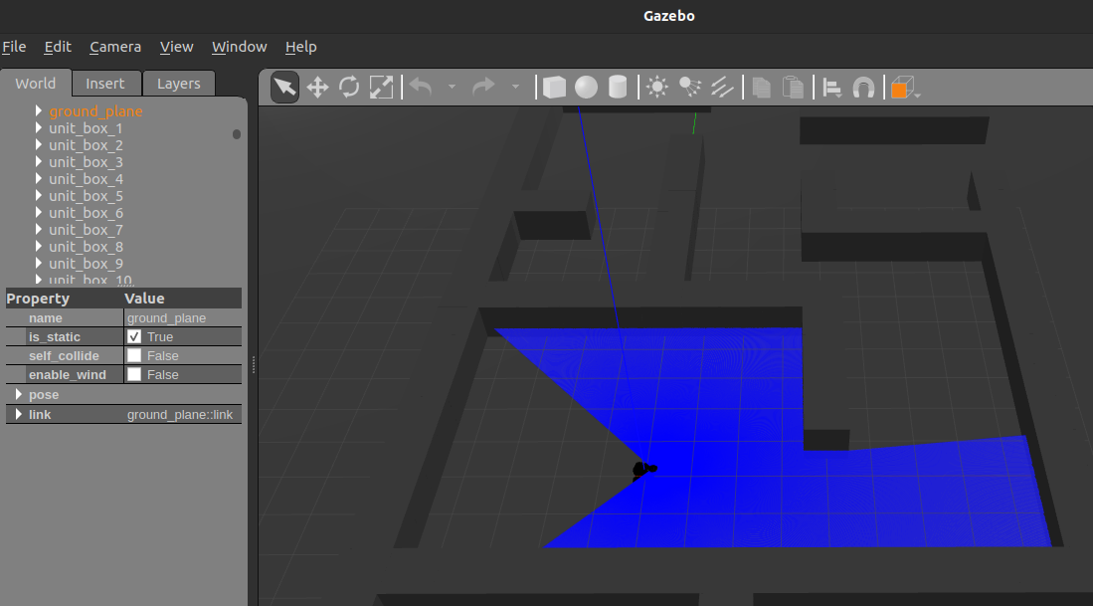
Gazebo Simulator
Gazebo is a popular physics simulator used very widely with ROS
With Gazebo, you can do robot programming without having to buy an actual robot
The physics simulator can closely approximate real-life implementation so it is useful for tests that risk hardware damage
In this lab, we will use Gazebo 11 (classic) for the simulations

Slide 5
Gazebo Simulator
To install Gazebo, open the terminal and type the following command:
Once installed, run Gazebo from the installed software or with the following terminal command:
Complete installation instructions can be found on the official Gazebo documentation:
curl -sSL http://get.gazebosim.org | sh
gazebo
https://classic.gazebosim.org/tutorials?tut=install_ubuntu&ver=11.0

Slide 6
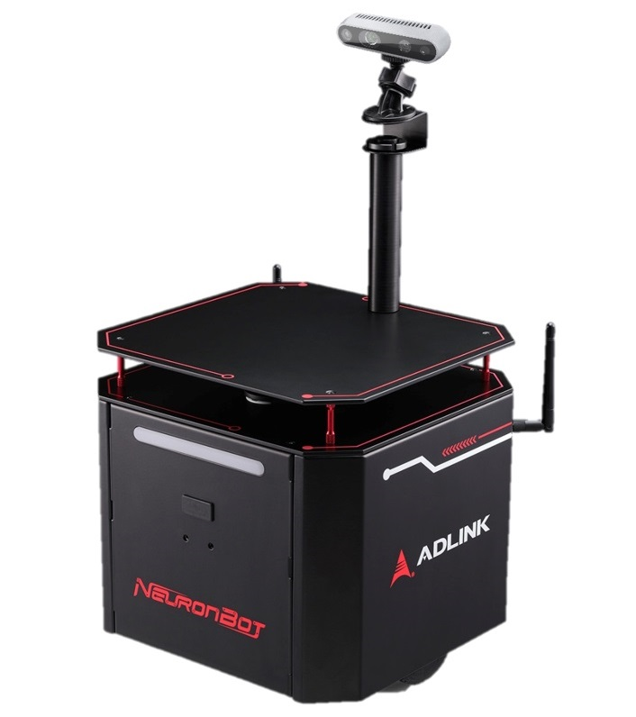
Example - NeuronBot2
NeuronBot2 is the latest version of NeuronBot created by Adlink
NeuronBot2 has support for both ROS1 and ROS2 (including Humble)
The NeuronBot2 repository can be found on GitHub which contains packages for testing, simulation, navigation as well as controlling the hardware
We can clone the package into our workspace in order to use it for simulations

Slide 7
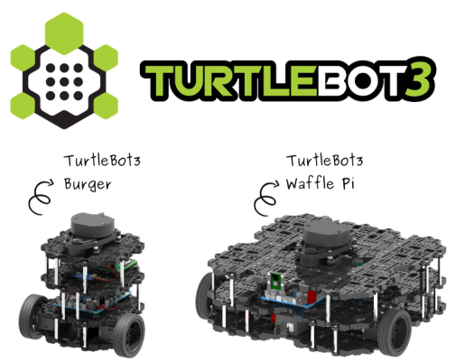
Example – TurtleBot3
Turtle Bot 3 is a compact, programmable mobile robot available for use in the domains of education, research, hobby, and prototyping.
It consists of various models such as Burger type, Waffle type

Slide 8
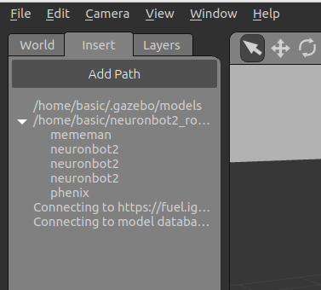
Gazebo Models
A package may contain several different models of a robot. For example, the NeuronBot2 package contains 3 models:
No camera
Camera on front
Camera on top
They all have the same name in the Insert tab of Gazebo but are actually different models that can be spawned separately in the environment
No camera
Camera on front
Camera on top

Slide 9
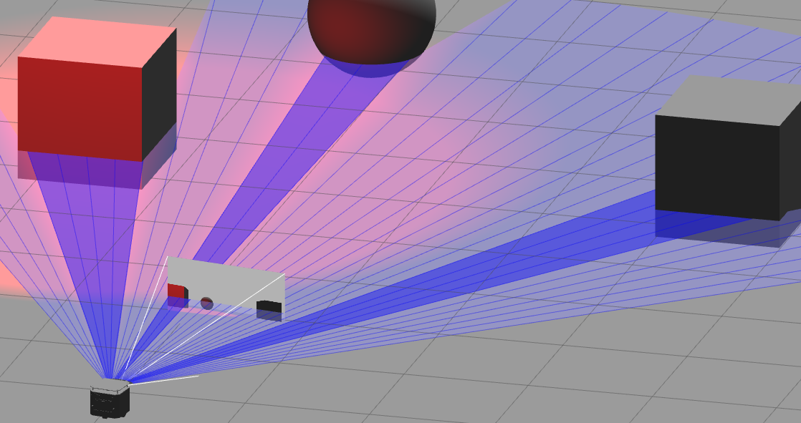
Laser and Camera
A robot may contain a camera and a laser range finder

Slide 10
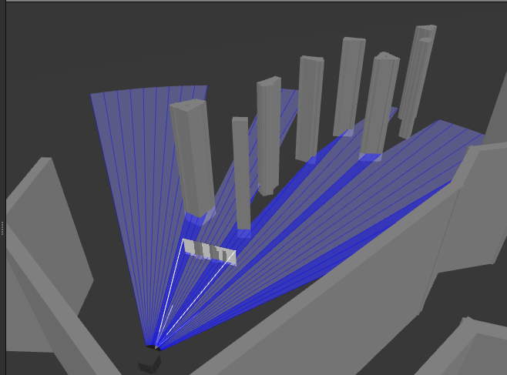
Laser Range Finder
The laser range finder is by default in 360 degrees
We will modify the laser span to about 90 degrees and reduce the number of laser samples. This is done to better visualize in the simulation and reduce unneeded computation costs
We will increase the span and samples when it will be required

Slide 11
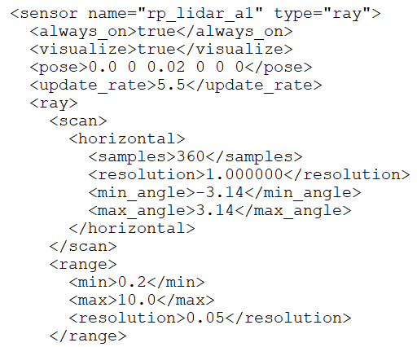
Laser Range Finder
To modify the laser, we will change the values in the model.sdf file for the robot
The sdf file contains XML code for the geometry of the robot and its individual parts (including the laser)
We will alter the values for the samples, min_angle and max_angle tags in the sdf file

Slide 12
Building Many Packages
The colcon build command is used to build the packages in the workspace whenever a new node is created or an existing node is modified
NeuronBot2 contains several packages such as neuronbot2_bringup, neuronbot2_gazebo which contain their own nodes
If we use colcon build, it will build all the packages. For a large number of packages, this will take a lot of time
To speed up building, we can build specific packages with the given command
colcon build –-packages-select <package-name>

Slide 13
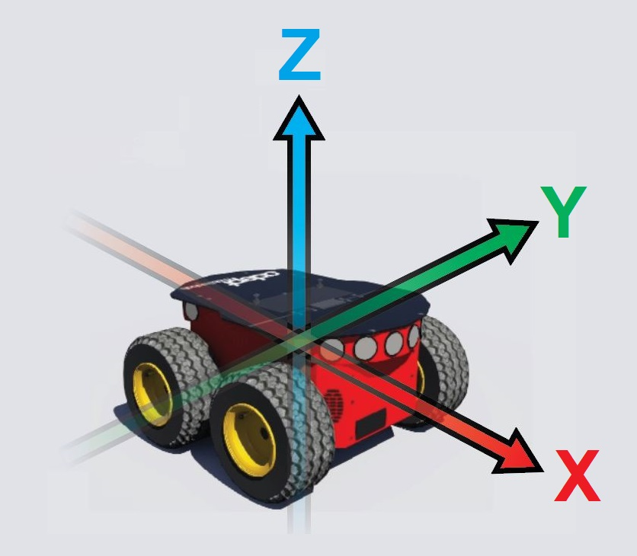
Mobile Robots
Mobile robots are those that have a movable base
In mobile robots, the convention is to use:
X-axis for forward and backward direction
Y-axis for sideways (or lateral) direction
Z-axis for vertical direction (aligned with gravity)
The motion may be linear; straight along the axis
The motion may be angular; rotation about the axis

Slide 14
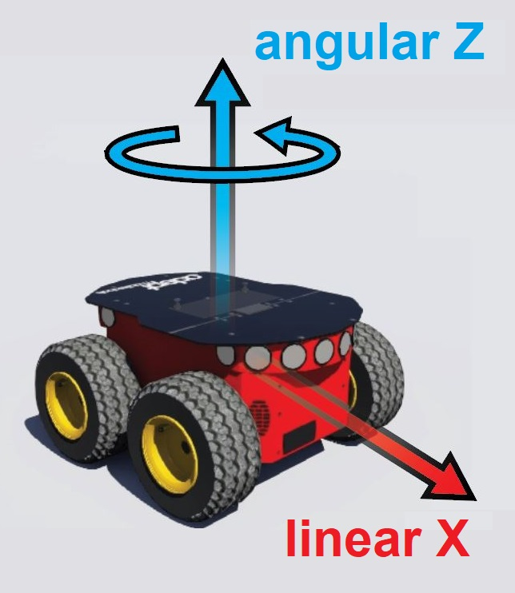
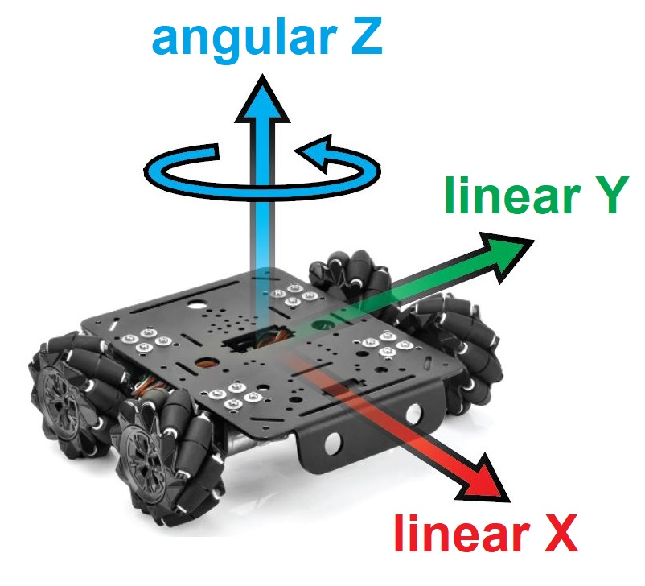
Mobile Robots
Robots with differential drive can move forward-backward (linear x) and turn (angular z)
Robots with omnidirectional drive can move forward-backward (linear x), sideways (linear y) and turn (angular z)

Slide 15
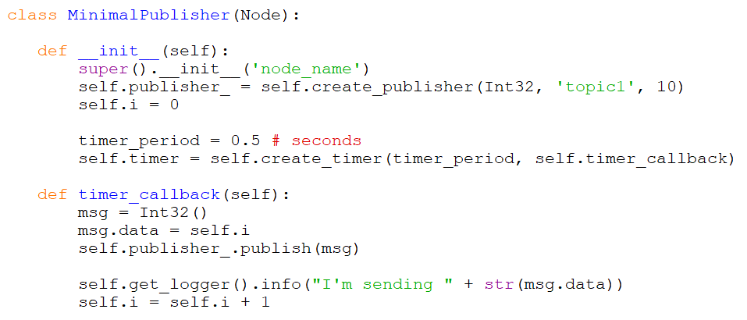
Publisher Node
This lab will focus on publisher nodes to command velocities to the robot:

Slide 16
Message Libraries
The std_msgs library contains message types for standard messages:
Int32
Float32
String
The geometry_msgs library contains message types for geometric data:
Pose
Point
Twist
Quaternion
The sensor_msgs library contains message types for sensor data:
Image
LaserScan
PointCloud
MagneticFIeld

Slide 17
Twist Messages
The geometry_msgs library contains message types for geometric data and includes message types such as Pose, Twist etc
The Twist message is a way to express linear and angular velocities in three dimensions
ROS software that interacts with mobile platforms virtually always uses a Twist message for the velocities
While it may seem easier to express motion in terms of wheel velocities, using Twist messages for the movement of the vehicle’s center allows the software to abstract away the kinematics of the vehicle
With such abstraction, whether the mobile platform’s actuators are arranged as differential drive, Ackermann steering, or omnidirectional drive is irrelevant

Slide 18
Twist Messages
A Twist message is a vector of 6 values each of float64 type
linear.x
linear.y
linear.z
angular.x
angular.y
angular.z
For wheeled robots that move on a flat 2-D surface (called planar robots) we only need the linear x, linear y and angular z velocities
The remaining velocities are used by robots that are capable of more general motions such as aerial, underwater and space robots. For example, a drone has linear z (thrust), angular x (roll), angular y (pitch) and angular z (yaw) velocities

Slide 19
Twist Messages
To use the twist messages, we need to include the dependency for geometry_msgs in the package
We can also add the dependency manually in package.xml file
With the dependency added, we can import the Twist message data type to use in our nodes:
ros2 pkg create –build-type ament_python myPackage
–-dependencies rclpy std_msgs geometry_msgs
–-node-name myNode
from geometry_msgs.msg import Twist

Slide 20
Twist Messages
After importing, we can initialize the Twist message object (in this lab, we will do this in the timer callback function):
We can set the linear velocity of the Twist object by:
We can set the angular velocity of the Twist object by:
Then these velocity messages can be published to a topic
The velocities topics is generally named as ‘cmd_vel’ in ROS programs
msg = Twist()
msg.linear.x = 1.0
msg.angular.x = 1.0
self.publisher_.publish(msg)

Slide 21
Lab Tasks
Download the manual from LMS
Perform the Lab Tasks as given in the manual and submit it on LMS
Remember to execute scripts with the terminal

